Slide 1


Provide company name plus your name and title,address, email, and mobile number.
INTRODUCTION TO COMPUTER NETWORKS
PROJECT PRESENTATION
BY TEAM -10
WEB BASED SMART HOME AUTOMATION USING RASPBERRY PI

Slide 2

TEAM MEMBERS
MANGAMURU SAI RISHITH REDDY -[CB.EN.U4AIE20036]
TSALIKI SATYA GANESH KUMAR- [CB.EN.U4AIE20073]
GUTTULA PAVAN -[CB.EN.U4AIE20020]
ILLA DINENSH KUMAR -[CB.EN.U4AIE20022]

Slide 3

OBJECTIVE
To design home automation system which will be fully control by the owner, to save people time and to survive in this more technological world.

Slide 4


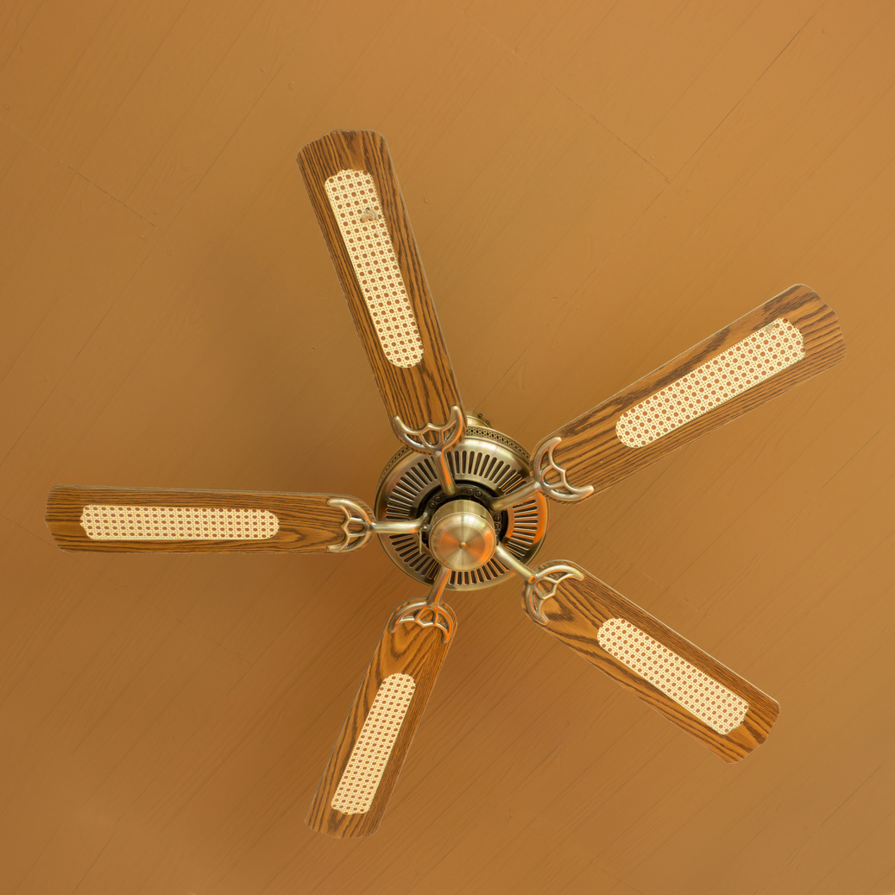
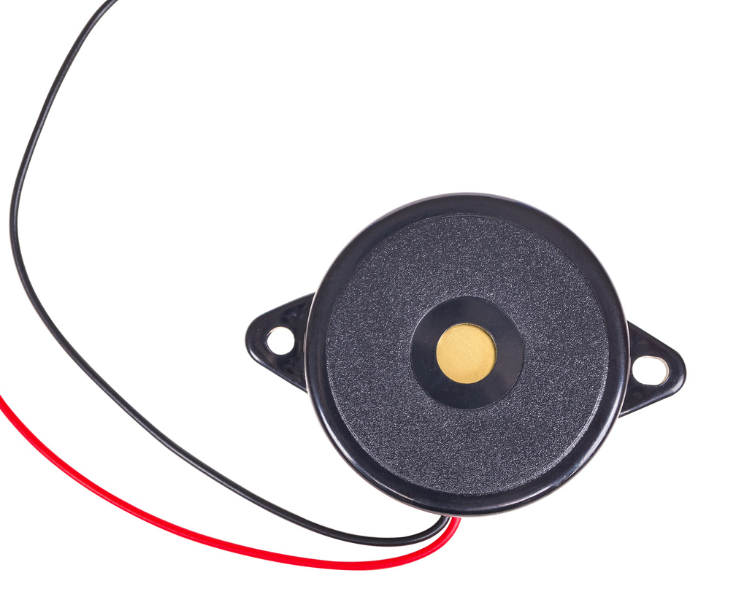
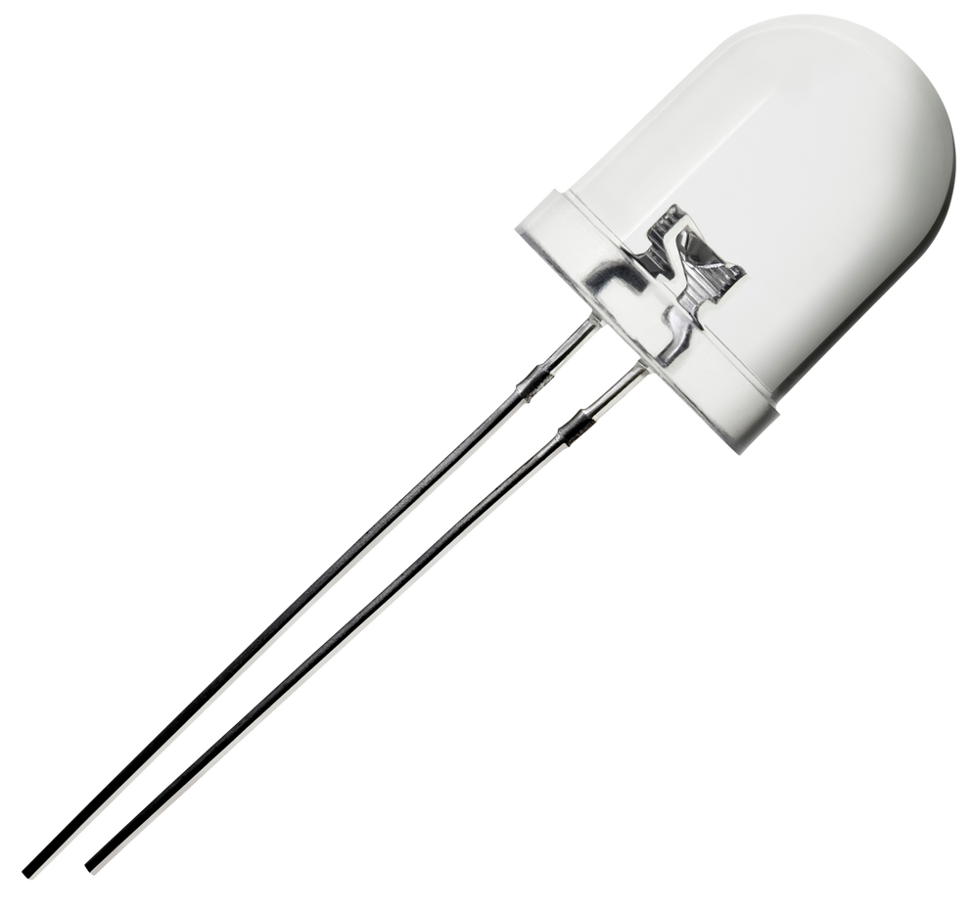
FEATURES
LED
BULB
FAN
BUZZER

Slide 5

HARDWARE REQUIREMENTS
Raspberrypi
Bulb
DC Motor
Driver Module
LED
Relay
Breadboard
Resistors
Jumper wires
DC power supply
Batteries
Buzzer

Slide 6
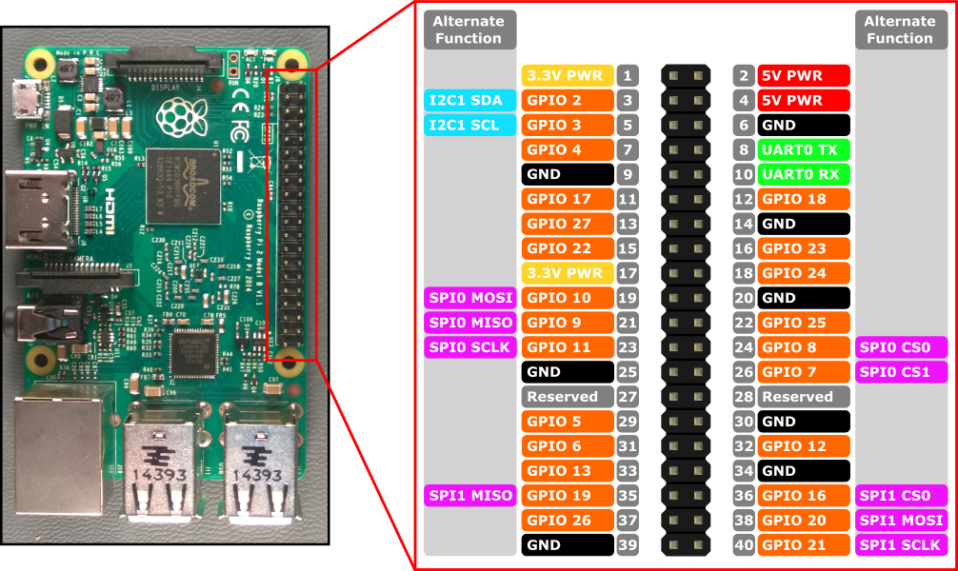
Raspberrypi
Raspberry Pi is a low-cost size computer that plugs into a computer monitor

Slide 7
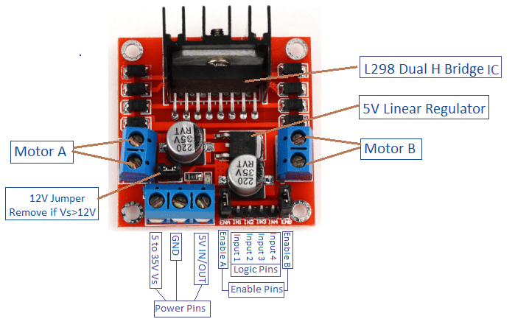
DRIVER MODULE
This L298N Motor Driver Module is a high power motor driver module for driving DC and Stepper Motors. This module consists of an L298 motor driver IC

Slide 8
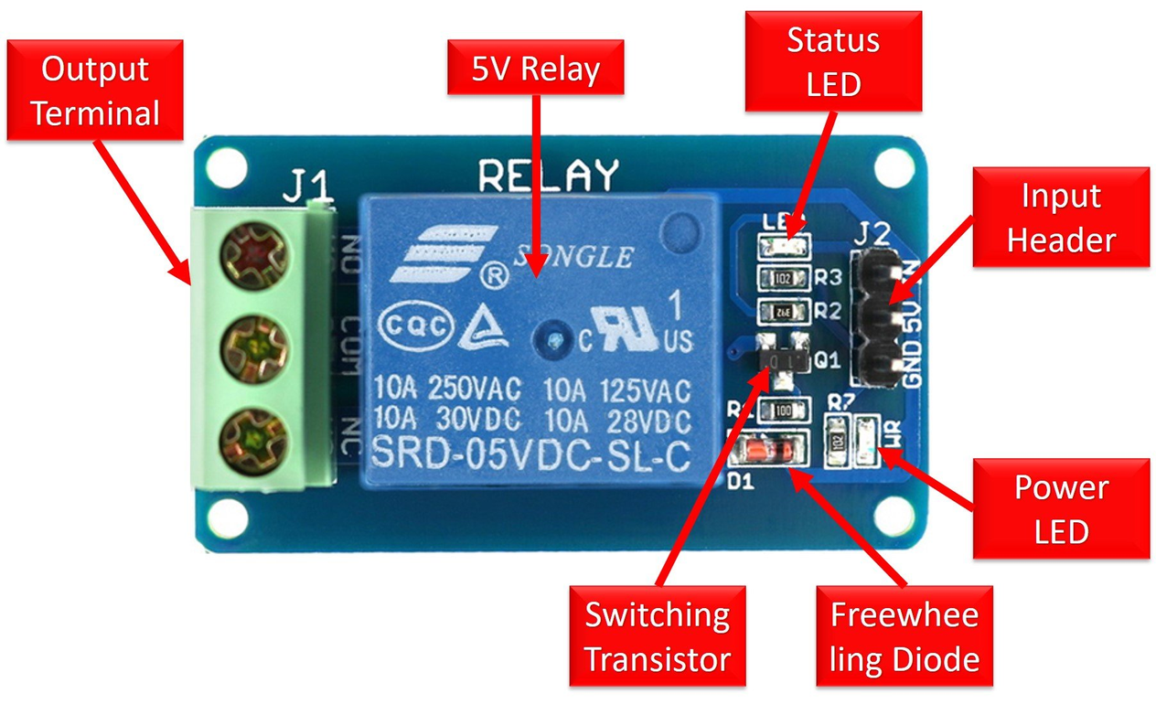
RELAY MODULE
A power relay module is an electrical switch that is operated by an electromagnet.

Slide 9

SOFTWARE REQUIREMENTS
Putty
Advance IP scanner
Vnc viewer
Raspberry OS

Slide 10
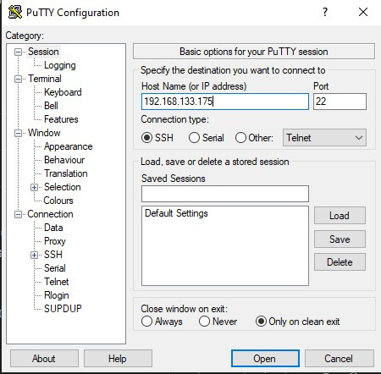
PUTTY
Used to connect devices over ip address

Slide 11
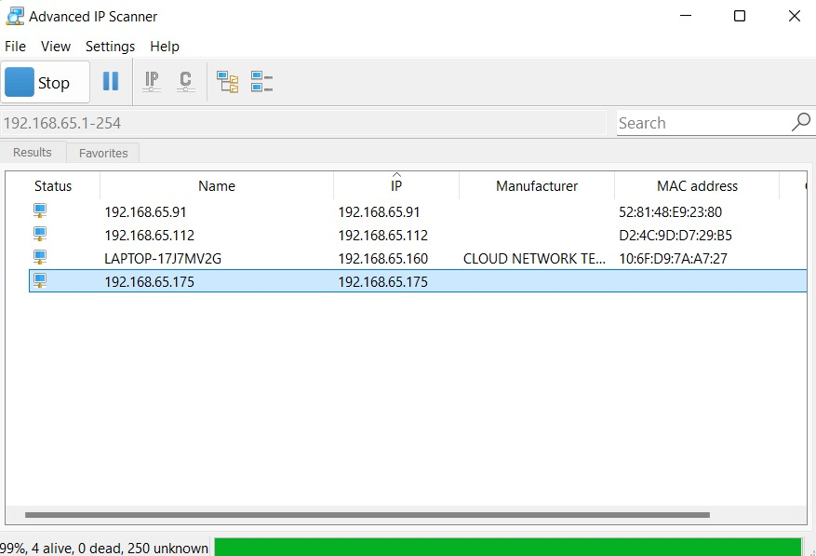
ADVANCE IP SCANNER
Used to scan the ip address of the devices.

Slide 12
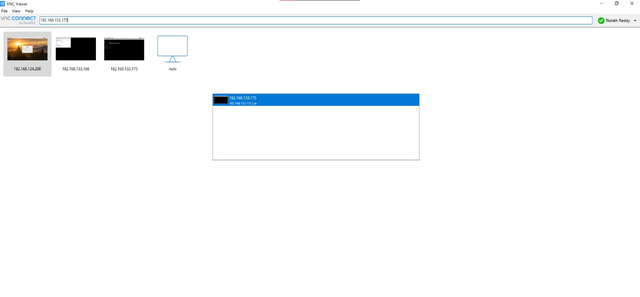
VNC VIEWER
Used to remotely control the pi over a GUI.

Slide 13
TOOLS
WebIOpi
ngrok
Control, debug, and use your Pi's GPIO, sensors and converters from a web browser or any app
ngrok is a cross-platform application that enables developers to expose a local development server to the Internet

Slide 14
Get the IP address of raspberry pi
ACCESSING
RASPBERRY
PI
SSH into it with the IP address
Connect to same network
Connected !!!

Slide 15
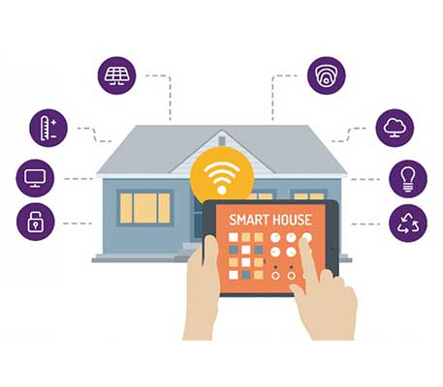
HOME AUTOMATION

Slide 16
APPROACH

Slide 17
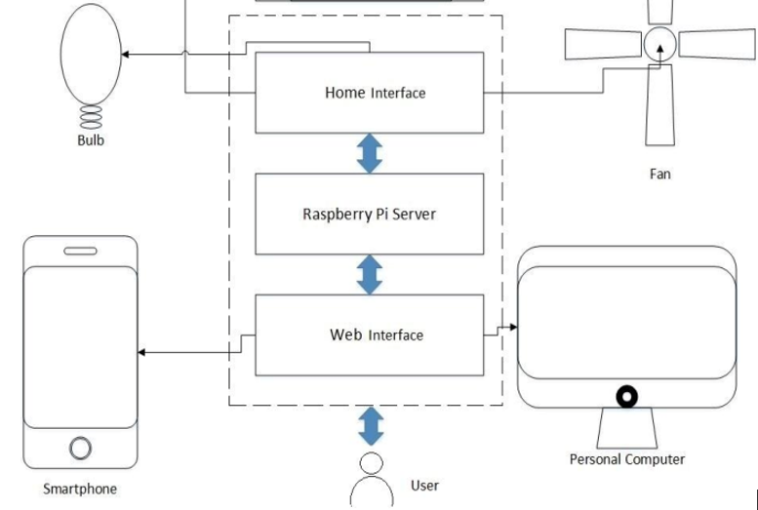

WORKING

Slide 18
Components Of Home Automation
1
2
3
SENSORS
CONTROLLERS
ACTUATORS

Slide 19
PROTOCALS
1
2
SSH
HTTP
Network communication protocol that enables two computers to communicate
used to load web pages using hypertext links.

Slide 20
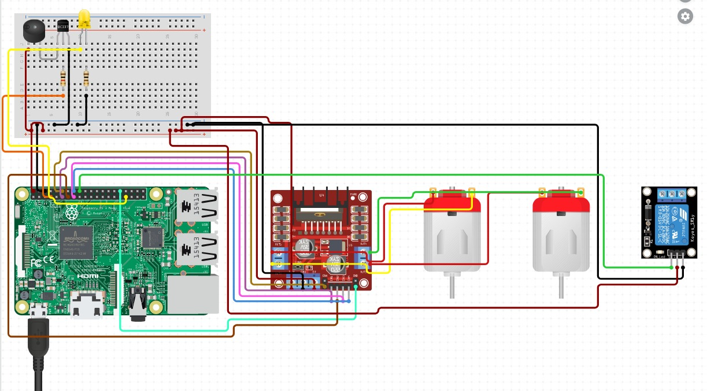
CIRCUIT

Slide 21
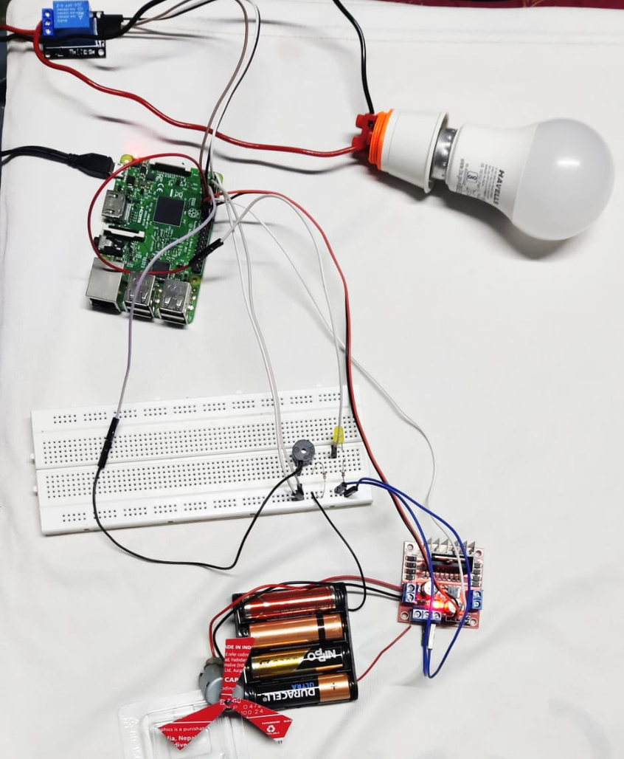
MODEL

Slide 22
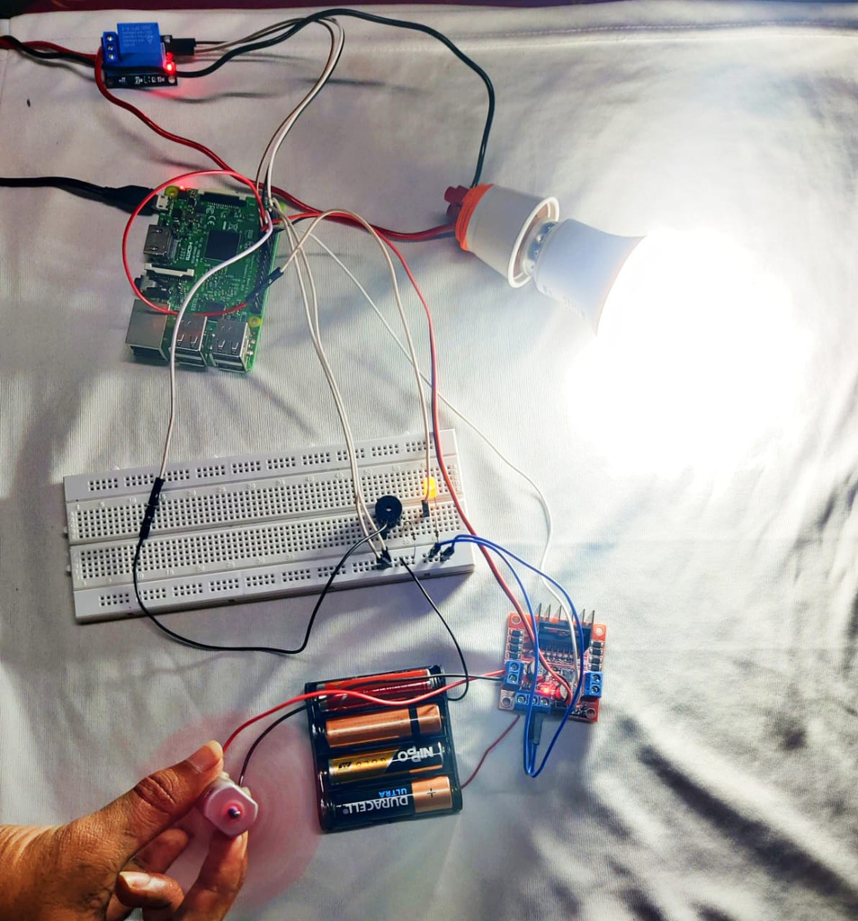
CONTROLLING
APPLIANCES

Slide 23
DEMO

Slide 24
ADVANTAGES
Access from anywhere
1
Easy to control
2
Fast and effective
3

Slide 25
DISADVANTAGES
Less secure
1
cost expensive
2
Always need internet
3

Slide 26
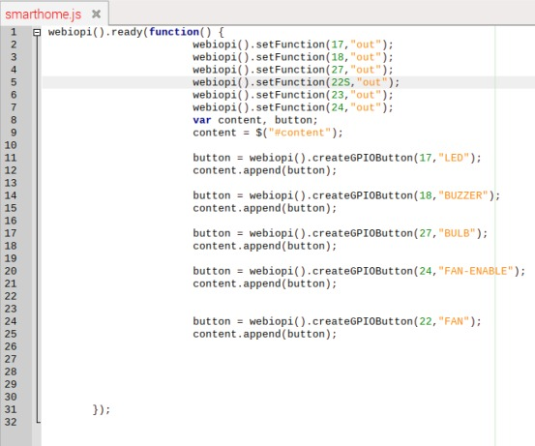
CODE

Slide 27
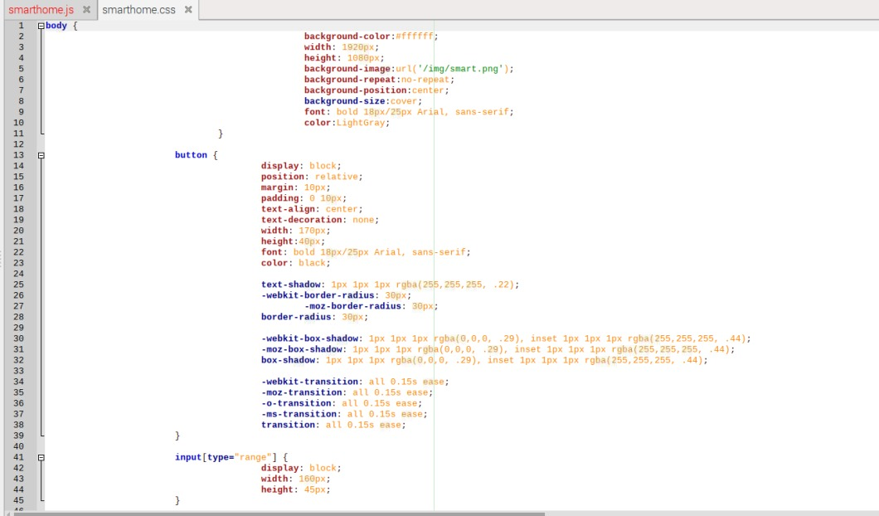

Slide 28
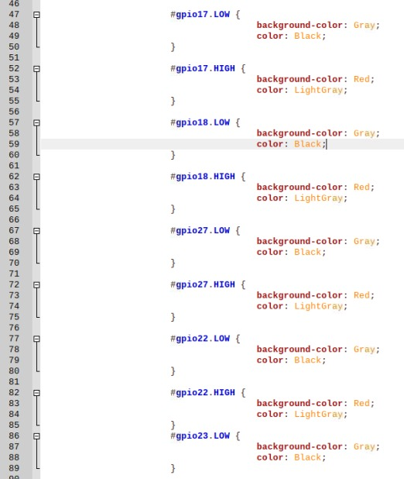
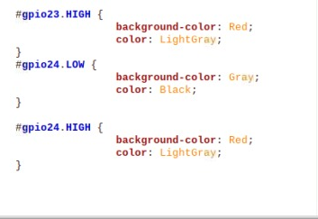

Slide 29
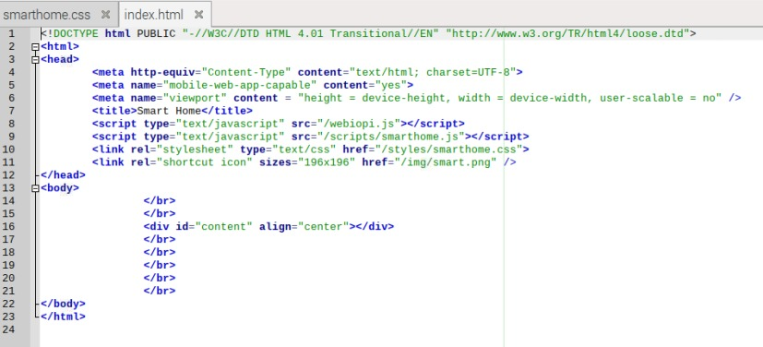
HTMLCODE

Slide 30
CONTRIBUTION
MANGAMURU SAI RISHITH REDDY -SOFTWARE(PIN CONFIG)
TSALIKI SATYA GANESH KUMAR- SOFTWARE(WEB PAGE)
GUTTULA PAVAN -HARDWARE
ILLA DINENSH KUMAR - HARDWARE

Slide 31
Thank You Mam !!

